Slide 1
DECO2300/DECO7230 Week 2 Practical
Unity Introduction II & Introduction to Meta SDK

Slide 2
Demonstrator Staff
Ben, Leon, Richard, Shuvodeep, Thisura, Yanzhuo , Zhijiang
Notes:
Introduce Yourself, Give a background. Talk about what your focus is (Tangible, Wearable, Mixed Reality, etc)

Slide 3
IN THIS TUTORIAL
Get Started with Unity
Basic Object Manipulation with Scripting
API docs & Scripting
Install Meta SDK
Simulate VR with Meta Simulator

Slide 4
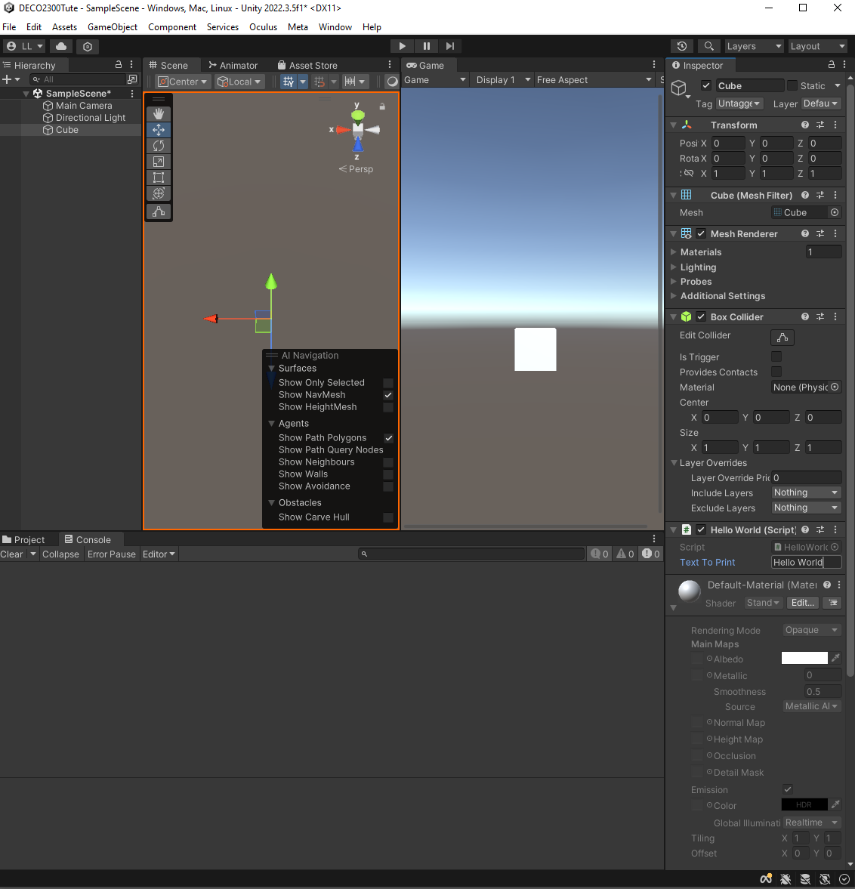
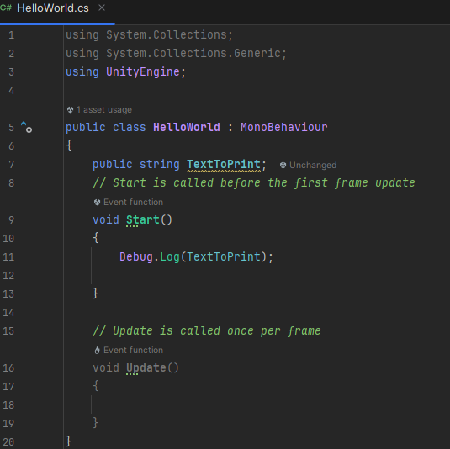
From Last Week References in C#
We previously got a reference to a string and Logged its value in the console.
Notes:
Debug.Log is really the only tool they need.

Slide 5
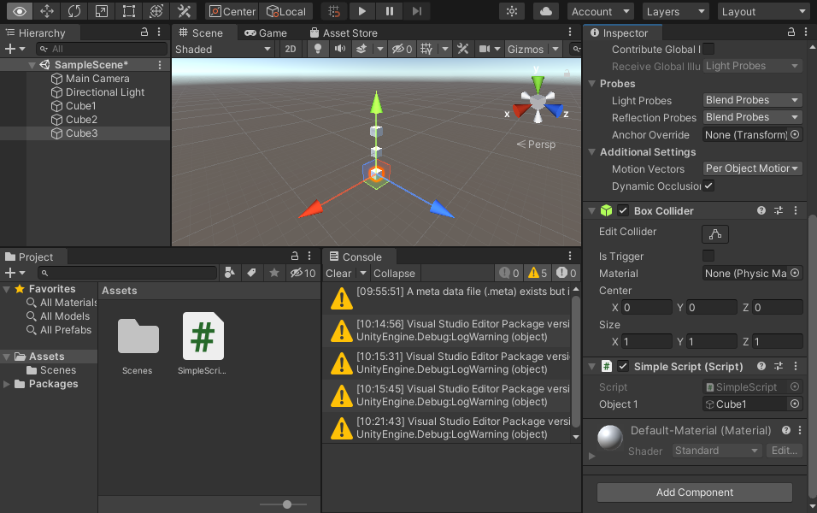
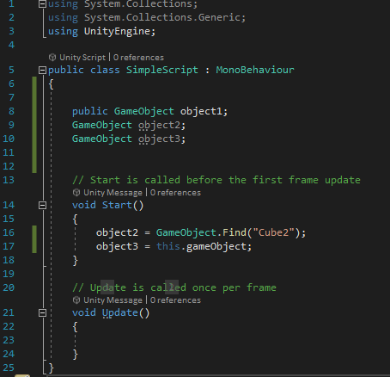
Unity Introduction: Coding Example
Similarly, we can get a reference to any other objects in the Scene.
Three methods:
Create a public/Serialized private variable then Drag object into the field in the Inspector (e.g., Cube1 is referenced as public GameObject object 1).
Find the object in the scene (e.g., Cube2 is referenced as object2 via GameObject.Find().
Get the object that this script is attached to (e.g., Cube3 is referenced as object3 and is directly accessible as the script is attached to it)
In this example, we create 3 cubes, a new script named SimpleScript. The script is attached to Cube3, from which references to the 3 cubes are assigned.
Notes:
Make three game objects.
While this is not best practice (normally they would have this a gameManager and it would load gameobjects on an event.) add this script to Cube3.
Program is as per the image. You will have to have the code compile to have it update the inspector and allow you to add a public GameObject

Slide 6
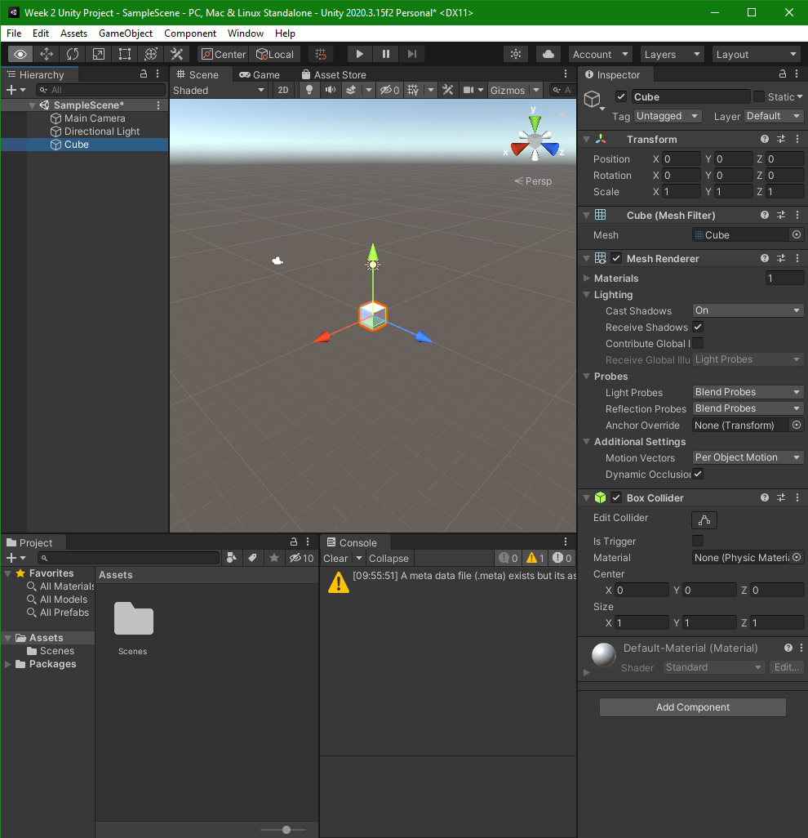
From Last Week: The Editor
Each GameObject is defined by a series of Components.
Notes:
Place an object in scene. Explain each window. Move, scale and rotate the GameObject. Explain each of these. Create and add a script then move to the next slide.

Slide 7
Unity Introduction: Object Manipulation
Each GameObject is defined by a series of Components.
Anything you see as a component in the Inspector can be accessed in scripts.
Notes:
Place an object in scene. Explain each window. Move, scale and rotate the GameObject. Explain each of these. Create and add a script then move to the next slide.

Slide 8
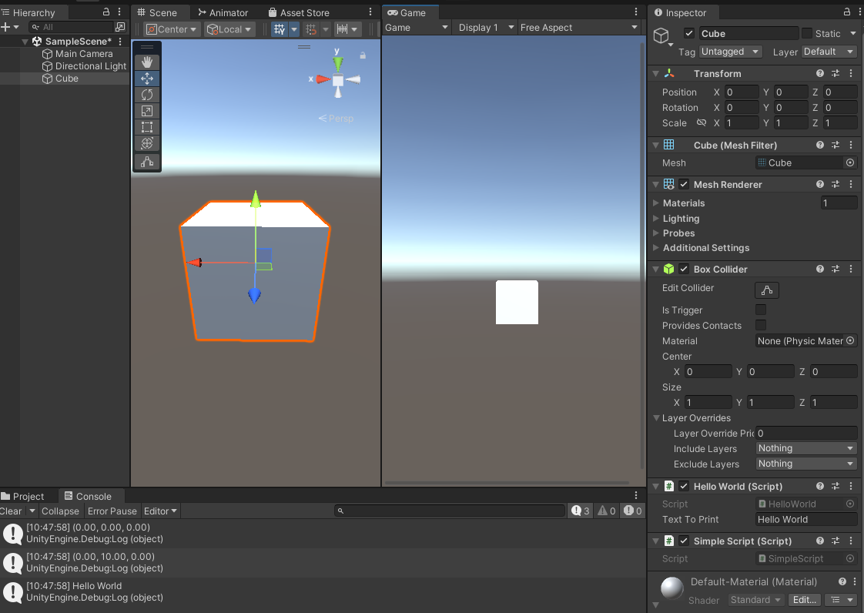
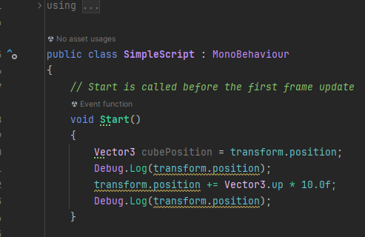
Unity Introduction: Object Manipulation
For example, we can access the Transform Component of our cube; all transforms have position, rotation and scale.
Correspondingly, in our script transform.position will give us access to the position of the GameObject where the script is attached to as a Vector3 (X,Y,Z).
The following code will move the GameObject up by a factor of 10.
“transform.position += Vector3.up * 10.0f”
Make sure you have attached your script to the GameObject you wish to manipulate in the Scene for the effect to take place
Y
Notes:
Vector3 is basically three floats (X,Y,Z)
Vector3.up is a simple way of saying (0,1,0)
Put it in start first to showcase that it moved and then swap it to update.
This will probably be waaayy too fast. Pause the scene and showcase how far the gameobject moved
So instead * Time.deltaTime —-- object1.transform.position += Vector3.up * Time.deltaTime
https://docs.unity3d.com/ScriptReference/Time-deltaTime.html
Which will make it update once per second rather then once per computer tick.

Slide 9
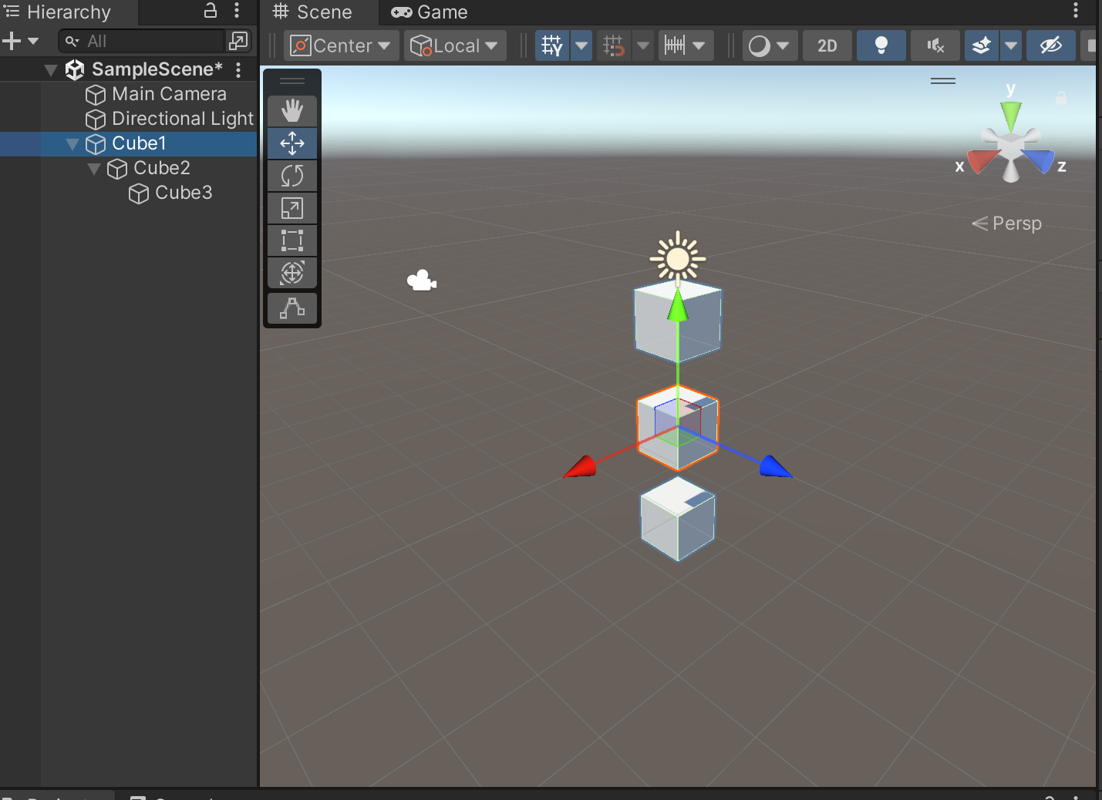
Unity Introduction: Parent/Child Relation
You can drag and drop a GameObject under another GameObject, making the former a child object of the latter.
Any changes to the Transform component on the parent object will be also applied to its child objects.
Activity: Create 3 cubes and arrange them as per the image. Change the position, rotation, scale of these objects (in Editor or in code) and see what happens
In this example, Cube3 is a child of Cube2, and Cube2 is a child of Cube1. Changing Cube1’s Transform attributes will also change the same attributes on Cube2 and Cube3.
Changes to Cube2 will be applied to Cube3 but not Cube1.
Changes to Cube3 will only take effect on itself.
Notes:
Make three game objects.
While this is not best practice (normally they would have this a gameManager and it would load gameobjects on an event.) add this script to Cube3.
Program is as per the image. You will have to have the code compile to have it update the inspector and allow you to add a public GameObject

Slide 10
Unity Introduction: Local/Global Relation
In another word, the Transform of child objects is in relation to its parent.
This is manifested in code:
Unity - Scripting API: Transform.position (unity3d.com)
Unity - Scripting API: Transform.localPosition (unity3d.com)
transform.position // gives you the world position of the GameObject transform.localPosition // gives you the position of the GameObject in relation to its parent, if it does not have a parent, the value will be the same as transform.position transform.rotation // same as for position transform.localRotation // same as for localPosition transform.lossyScale // gives you the global scale of the GameObject (Read-only) transform.localScale // same as for localPosition
Notes:
Make three game objects.
While this is not best practice (normally they would have this a gameManager and it would load gameobjects on an event.) add this script to Cube3.
Program is as per the image. You will have to have the code compile to have it update the inspector and allow you to add a public GameObject

Slide 11
Unity Introduction: Local/Global Relation
public class LocalGlobalExample : MonoBehaviour { // Attach the script to Cube1, make Cube2 a child of Cube1,and Cube3 a child of Cube2 public Transform cube1; public Transform cube2; public Transform cube3; // Start is called before the first frame update void Start() { // Get references to the objects - in this case since they are all public, // you may also comment the code and assign the cubes via the editor cube1 = this.transform; cube2 = cube1.Find("Cube2"); cube3 = cube2.Find("Cube3"); // Change Cube1's position/rotation/scale Debug.Log("Change Cube1's position to (0,0,1)"); cube1.position = new Vector3(0, 0, 1); Debug.Log("Cube1's Position is:" + cube1.position); Debug.Log("Cube1's LocalPosition is:" + cube1.localPosition); Debug.Log("Cube2's Position is:" + cube3.parent.position); //cube3.parent is equivalent to cube2 Debug.Log("Cube2's LocalPosition is:"+cube2.localPosition); Debug.Log("Cube3's Position is:" + cube3.position); Debug.Log("Cube3's LocalPosition is:"+cube3.localPosition); // Change Cube2's rotation Debug.Log("Change Cube2's rotation to (0,30,0)"); cube2.localRotation = Quaternion.Euler(0,30,0); Debug.Log("Cube1's Rotation is:" + cube1.rotation.eulerAngles); Debug.Log("Cube1's LocalRotation is:" + cube1.localRotation.eulerAngles); Debug.Log("Cube2's Rotation is:" + cube3.parent.rotation.eulerAngles); Debug.Log("Cube2's LocalRotation is:"+cube2.localRotation.eulerAngles); Debug.Log("Cube3's Rotation is:" + cube3.rotation.eulerAngles); Debug.Log("Cube3's LocalRotation is:"+cube3.localRotation.eulerAngles); // Change Cube3's scale Debug.Log("Change Cube3's scale to (2,2,2)"); cube3.localScale = new Vector3(2, 2, 2); Debug.Log("Cube1's Scale is:" + cube1.lossyScale); Debug.Log("Cube1's LocalScale is:" + cube1.localScale); Debug.Log("Cube2's Scale is:" + cube2.lossyScale); Debug.Log("Cube2's LocalScale is:" + cube2.localScale); Debug.Log("Cube3's Scale is:" + cube3.lossyScale); Debug.Log("Cube3's LocalScale is:" + cube3.localScale); } }
In another word, the Transform of child objects is in relation to its parent.
Activity: Understand this in code.
In Scene, make Cube1 the parent of Cube2, and Cube2 the parent of Cube3.
Make a new script and attach it to Cube1. Change position/rotation/scale attributes of Cube1/Cube2/Cube3 and log them out in Console.
See the difference in their values.
Notes:
Make three game objects.
While this is not best practice (normally they would have this a gameManager and it would load gameobjects on an event.) add this script to Cube3.
Program is as per the image. You will have to have the code compile to have it update the inspector and allow you to add a public GameObject

Slide 12
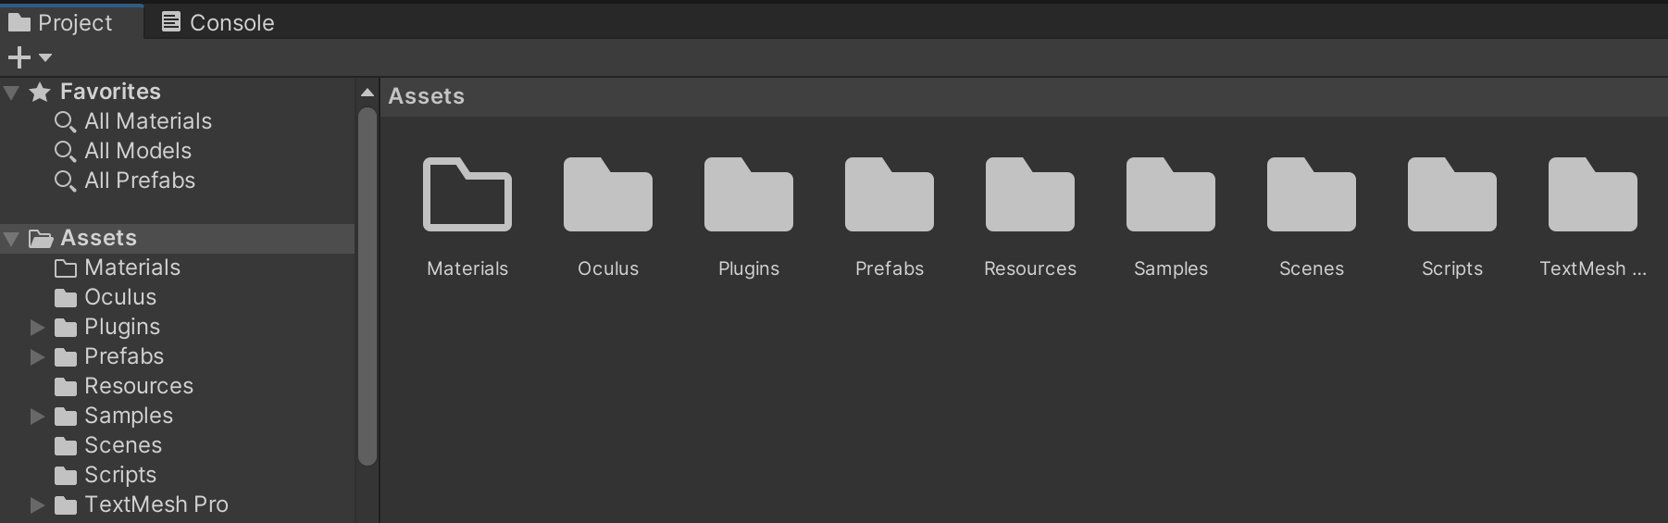
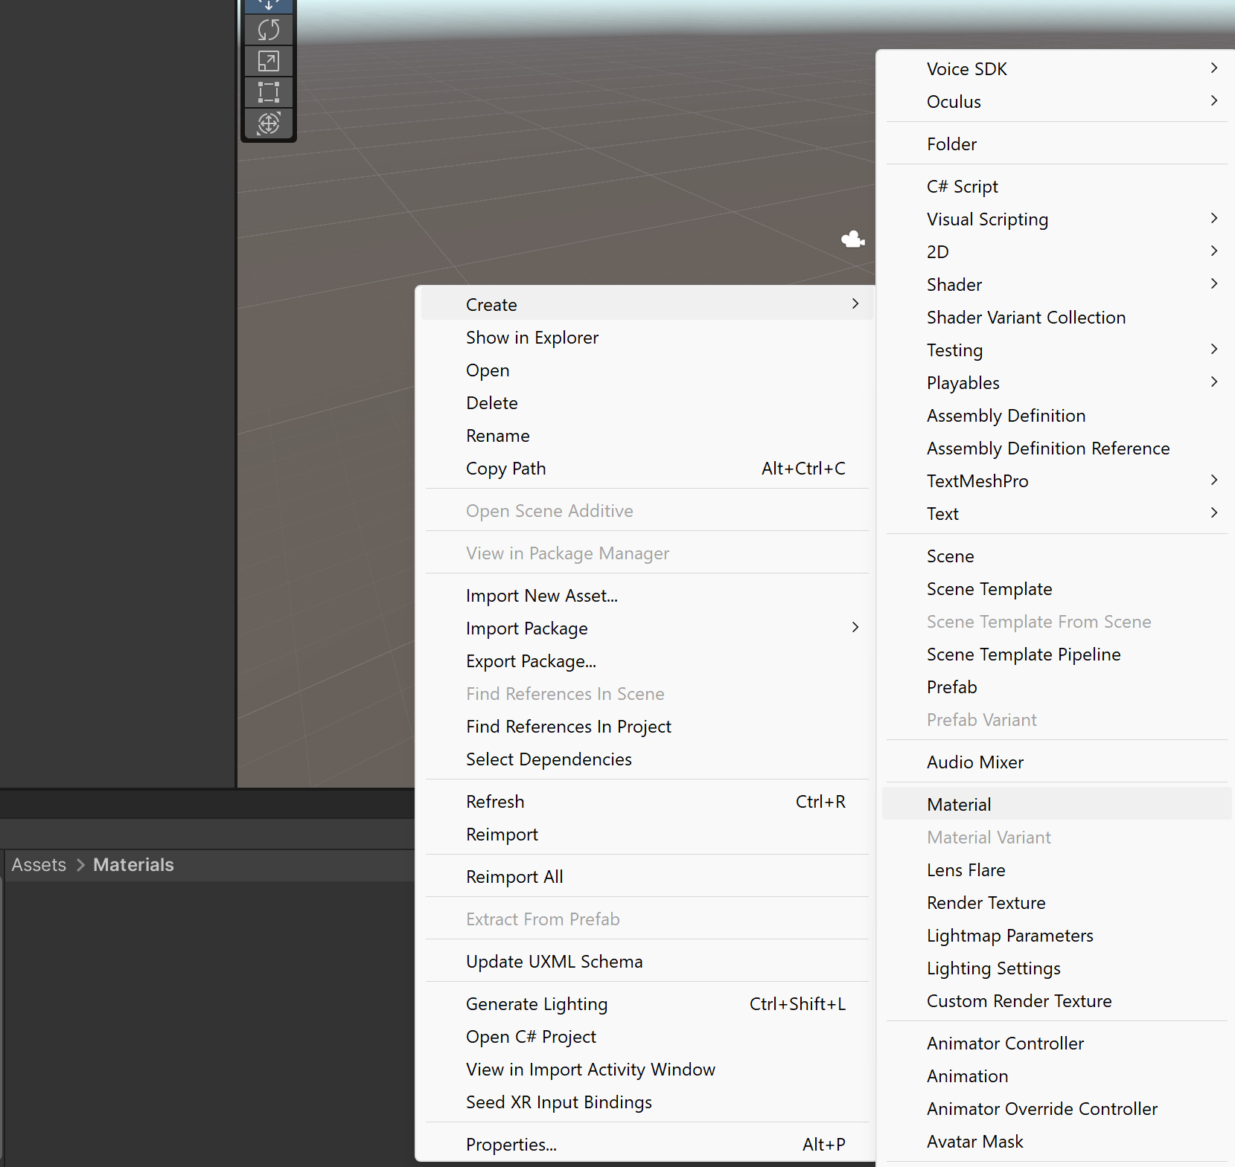
Unity Introduction: Object Manipulation
We can attach Materials to objects. Materials provide colours, textures to the object’s look. You can create new materials in Unity Editor:
In Project view, create a new folder under Assets and name it ‘Materials’ > Inside the folder, right-click > Create > Material
Notes:
Vector3 is basically three floats (X,Y,Z)
Vector3.up is a simple way of saying (0,1,0)
Put it in start first to showcase that it moved and then swap it to update.
This will probably be waaayy too fast. Pause the scene and showcase how far the gameobject moved
So instead * Time.deltaTime —-- object1.transform.position += Vector3.up * Time.deltaTime
https://docs.unity3d.com/ScriptReference/Time-deltaTime.html
Which will make it update once per second rather then once per computer tick.

Slide 13
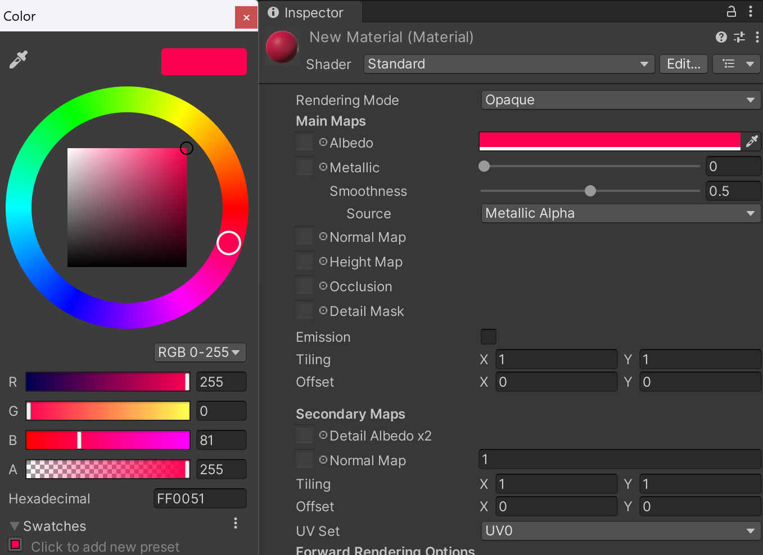
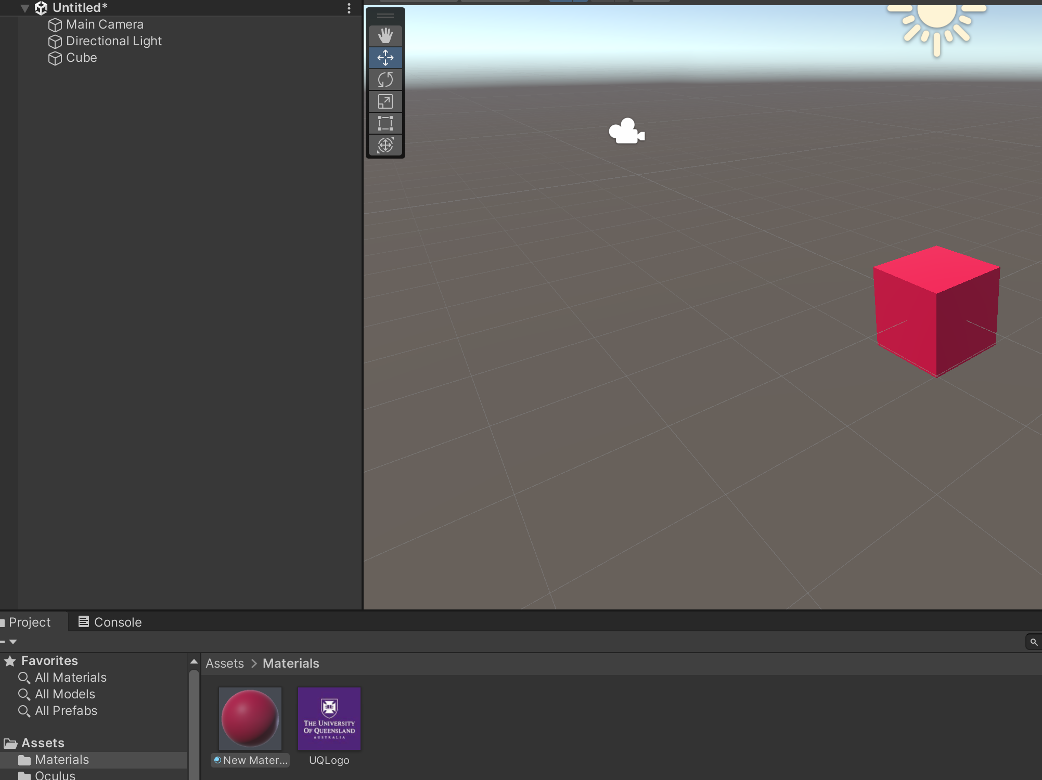
Unity Introduction: Object Manipulation
You can define the material’s attributes, such as Color, Shader, and Rendering Mode in the Inspector Pane (try them yourself and see what happens)
To apply a material, simply drag and drop it to a GameObject in the Scene
Drag and drop
Notes:
Vector3 is basically three floats (X,Y,Z)
Vector3.up is a simple way of saying (0,1,0)
Put it in start first to showcase that it moved and then swap it to update.
This will probably be waaayy too fast. Pause the scene and showcase how far the gameobject moved
So instead * Time.deltaTime —-- object1.transform.position += Vector3.up * Time.deltaTime
https://docs.unity3d.com/ScriptReference/Time-deltaTime.html
Which will make it update once per second rather then once per computer tick.

Slide 14
Unity Introduction: Object Manipulation
Similarly, this can be accessed and manipulated with code, via:
transform.GetComponent<MeshRenderer>().material
This will give us access to the material of the GameObject.
We can change the colour via the material.color property. There are a few preset colours available in the Color class (Color.Blue …). You can also create you own colour.
Notes:
Vector3 is basically three floats (X,Y,Z)
Vector3.up is a simple way of saying (0,1,0)
Put it in start first to showcase that it moved and then swap it to update.
This will probably be waaayy too fast. Pause the scene and showcase how far the gameobject moved
So instead * Time.deltaTime —-- object1.transform.position += Vector3.up * Time.deltaTime
https://docs.unity3d.com/ScriptReference/Time-deltaTime.html
Which will make it update once per second rather then once per computer tick.

Slide 15

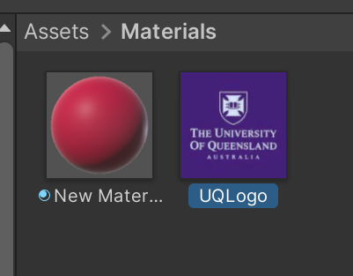
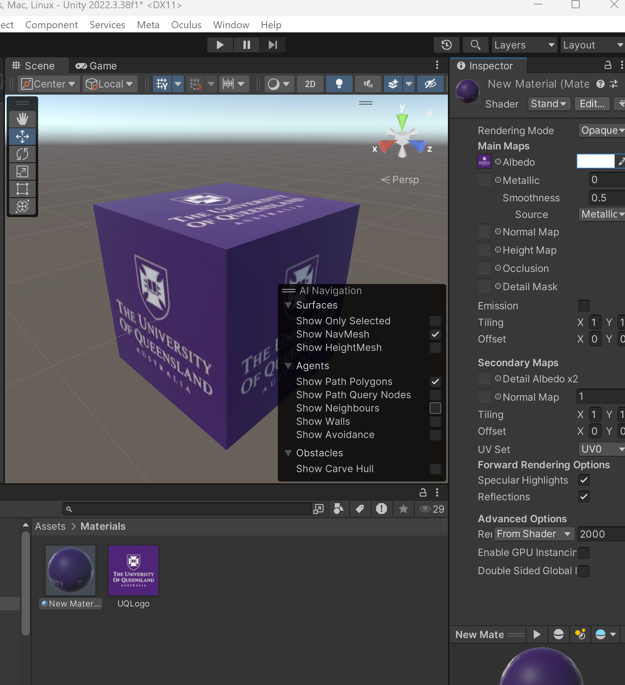
Unity Introduction: Object Manipulation
You can also change the material’s texture:
Drag and drop the texture image you prepared into the Material folder (UQ logo in this case)
Then drag and drop the texture to the Albedo field of the material.
Drag and drop
Notes:
Vector3 is basically three floats (X,Y,Z)
Vector3.up is a simple way of saying (0,1,0)
Put it in start first to showcase that it moved and then swap it to update.
This will probably be waaayy too fast. Pause the scene and showcase how far the gameobject moved
So instead * Time.deltaTime —-- object1.transform.position += Vector3.up * Time.deltaTime
https://docs.unity3d.com/ScriptReference/Time-deltaTime.html
Which will make it update once per second rather then once per computer tick.

Slide 16
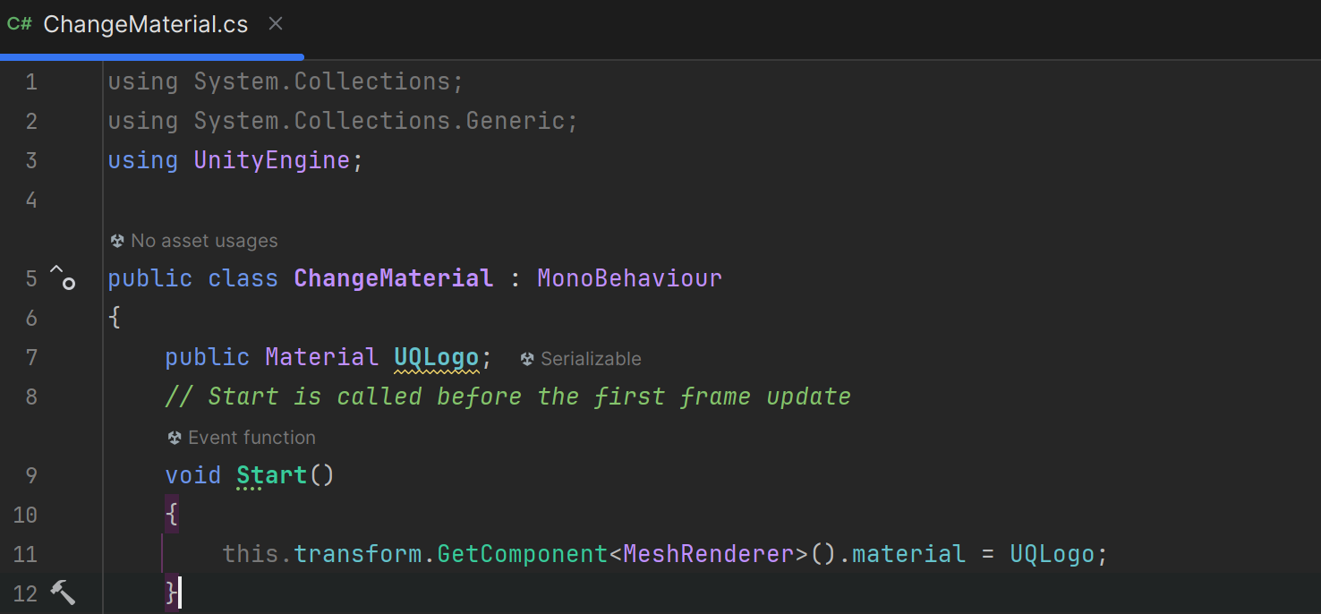
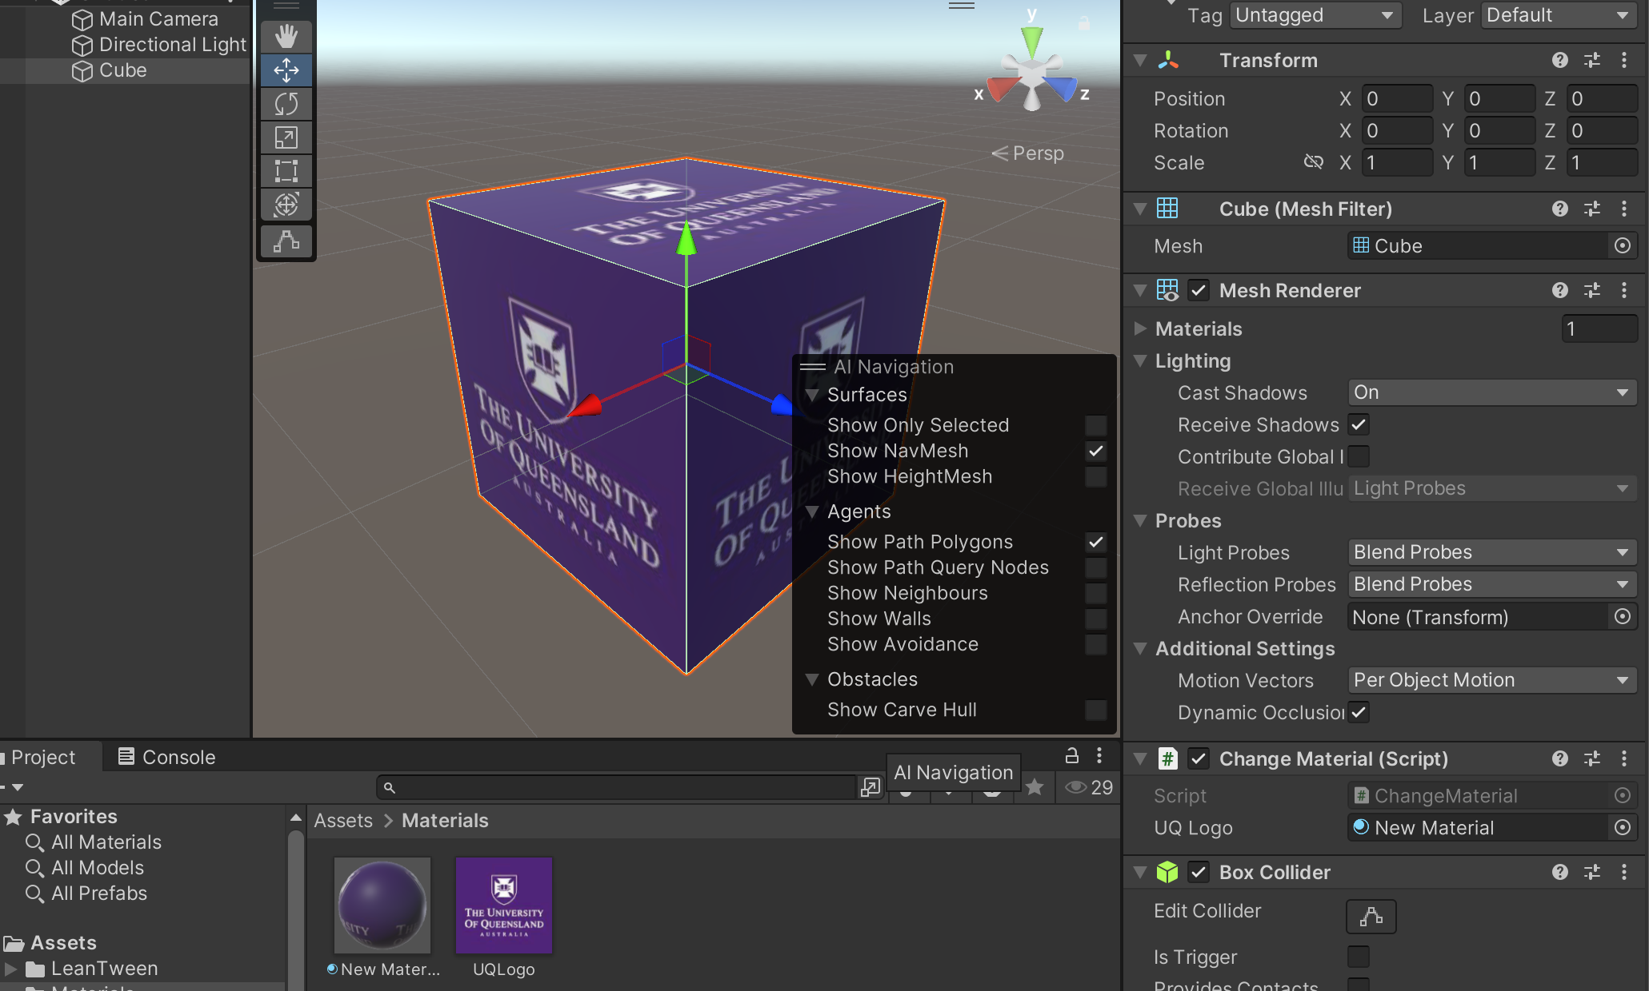
Unity Introduction: Object Manipulation
This can be also done via code, with a reference to the material
Again, make sure you have attached your script to the GameObject you wish to manipulate in the Scene, or you have properly referenced the GameObject in the script for the effect to take place
Drag and drop
Notes:
Vector3 is basically three floats (X,Y,Z)
Vector3.up is a simple way of saying (0,1,0)
Put it in start first to showcase that it moved and then swap it to update.
This will probably be waaayy too fast. Pause the scene and showcase how far the gameobject moved
So instead * Time.deltaTime —-- object1.transform.position += Vector3.up * Time.deltaTime
https://docs.unity3d.com/ScriptReference/Time-deltaTime.html
Which will make it update once per second rather then once per computer tick.

Slide 17
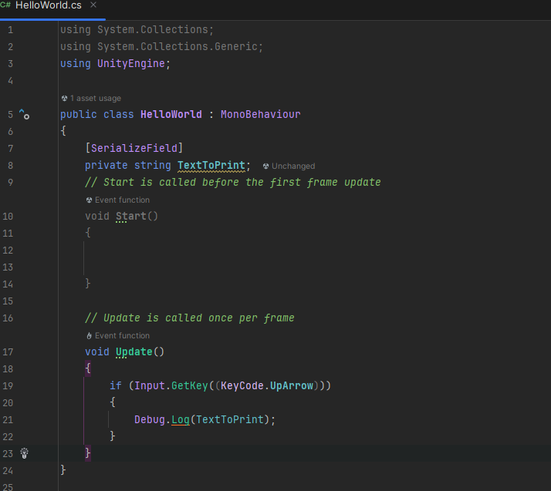
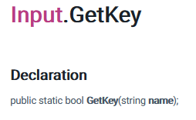
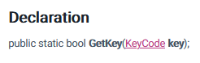
From Last Week:
Get a key press.
https://docs.unity3d.com/ScriptReference/Input.GetKey.html
Keycode reference:
https://docs.unity3d.com/ScriptReference/KeyCode.html
We previously made a simple interaction to log “Hello World” whenever the up arrow key is pressed.
Notes:
Throw the transform code in here but change 10 to a variable (no magic numbers).

Slide 18
Exercise:
Get a key press.
https://docs.unity3d.com/ScriptReference/Input.GetKey.html
Keycode reference:
https://docs.unity3d.com/ScriptReference/KeyCode.html
We previously made a simple interaction to log “Hello World” whenever the up arrow key is pressed.
Can you make a similar interaction to
Move the cube
Change the colour of the cube?
Rotate the cube (hint: transform.rotation += new Quternion(x,y,z,w), or transform.Rotate(), you can find references to these methods from the documentation too)
Notes:
Throw the transform code in here but change 10 to a variable (no magic numbers).

Slide 19
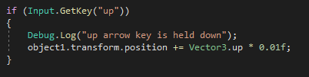
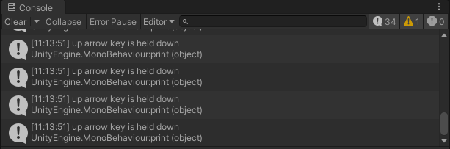
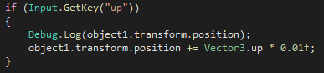
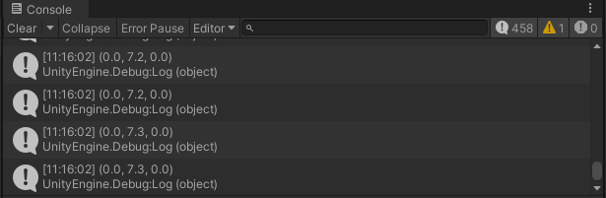
Unity Introduction: Debugging
Debug.Log();
Helps tell you if a piece of code is running.
Prints the values of variables.
Notes:
Debug.Log is really the only tool they need.

Slide 20
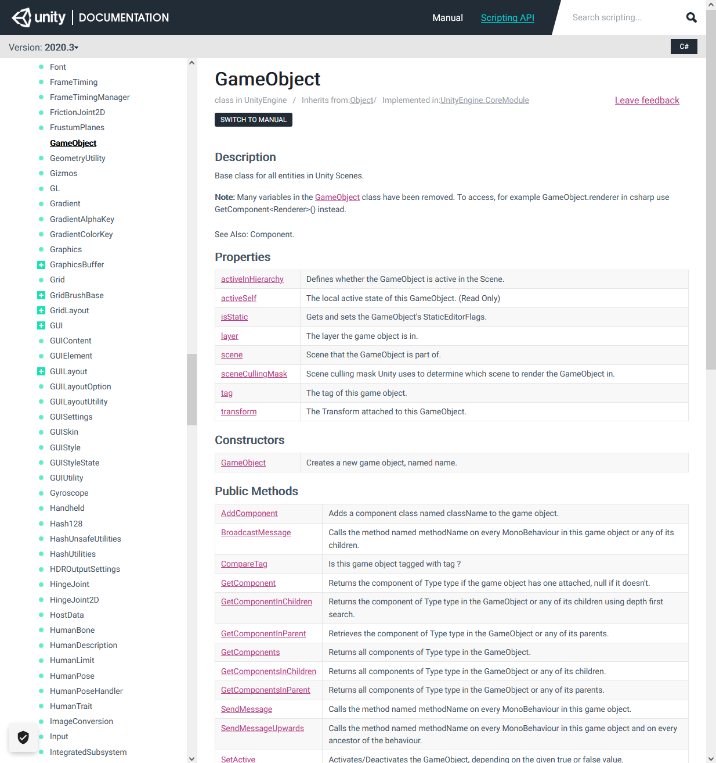
Unity Introduction: API Documentation
Explains everything about coding with the unity libraries.
https://docs.unity3d.com/ScriptReference/
Also check out:
https://docs.unity3d.com/ScriptReference/Input.html
https://docs.unity3d.com/ScriptReference/Vector3.html
https://docs.unity3d.com/ScriptReference/Collider.html
https://docs.unity3d.com/ScriptReference/GameObject.html
Notes:
This is basically the be all and end all for everything in unity but the examples are pretty trash.
The ol’ google Fu will get you better examples just be warned that the examples might be over a decade old.

Slide 21
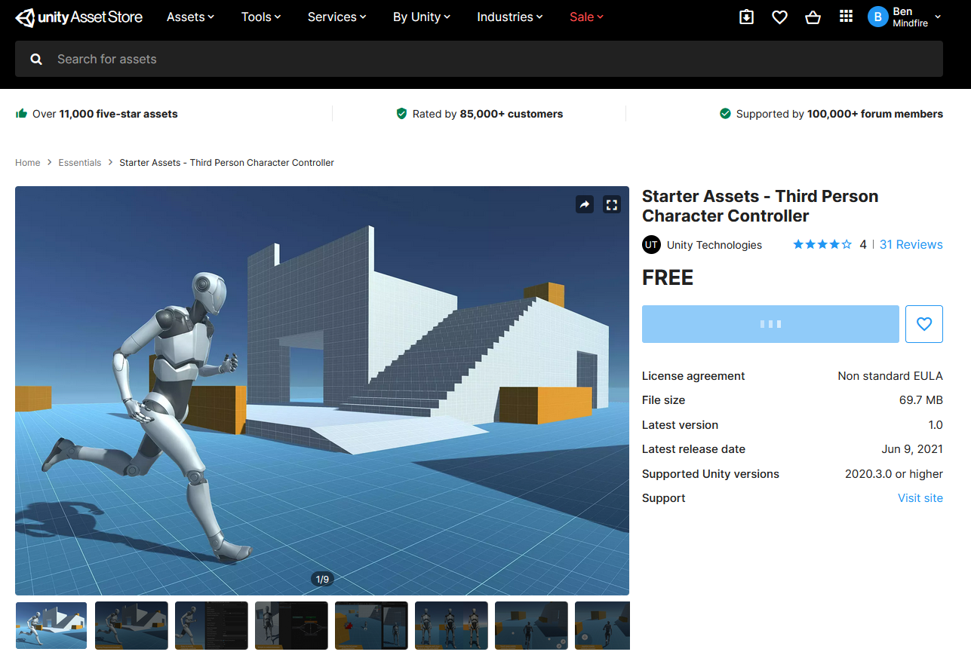
Unity Introduction: Assets
https://assetstore.unity.com/
You are free to use Unity Assets from the store so long as you take the following into account.
You need to reference it
It's not the only thing in your prototype
Serves a purpose
Search the asset store for free assets.
You don’t ever NEED to do this.
https://assetstore.unity.com/packages/essentials/starter-assets-third-person-character-controller-196526#content
Notes:
Big thing to stress is that while we might not mark code (do we mark code?), if they only put up a unity store asset and some tutorial it will be almost impossible for them to collect any good data as the prototype has not been created to answer a specific question. Rather it has been defined by the assets they could find.

Slide 22
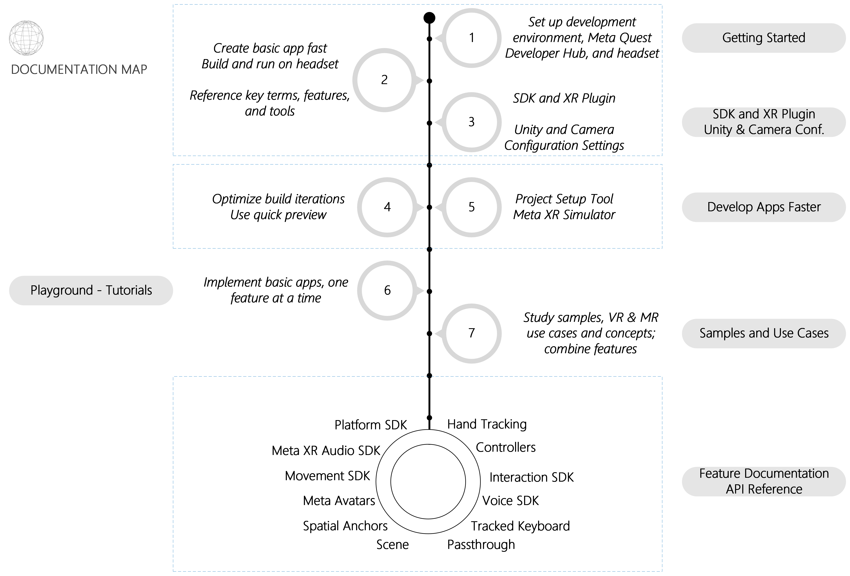
Meta All-in-one SDK – Overview
In this session, we will briefly cover every step circled in purple.

Slide 23
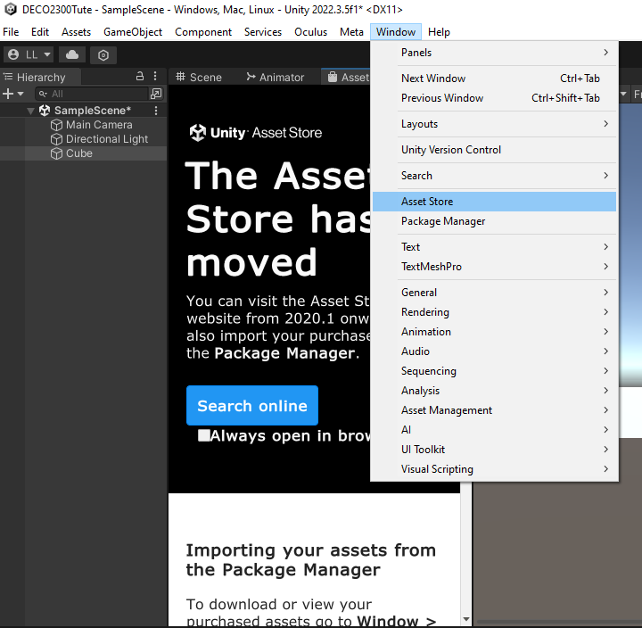
Meta XR All-in-One SDK: Install from Unity AssetStore
Open last week’s project, then go to Window -> Asset Store -> Search online
Notes:
Place an object in scene. Explain each window. Move, scale and rotate the GameObject. Explain each of these. Create and add a script then move to the next slide.

Slide 24

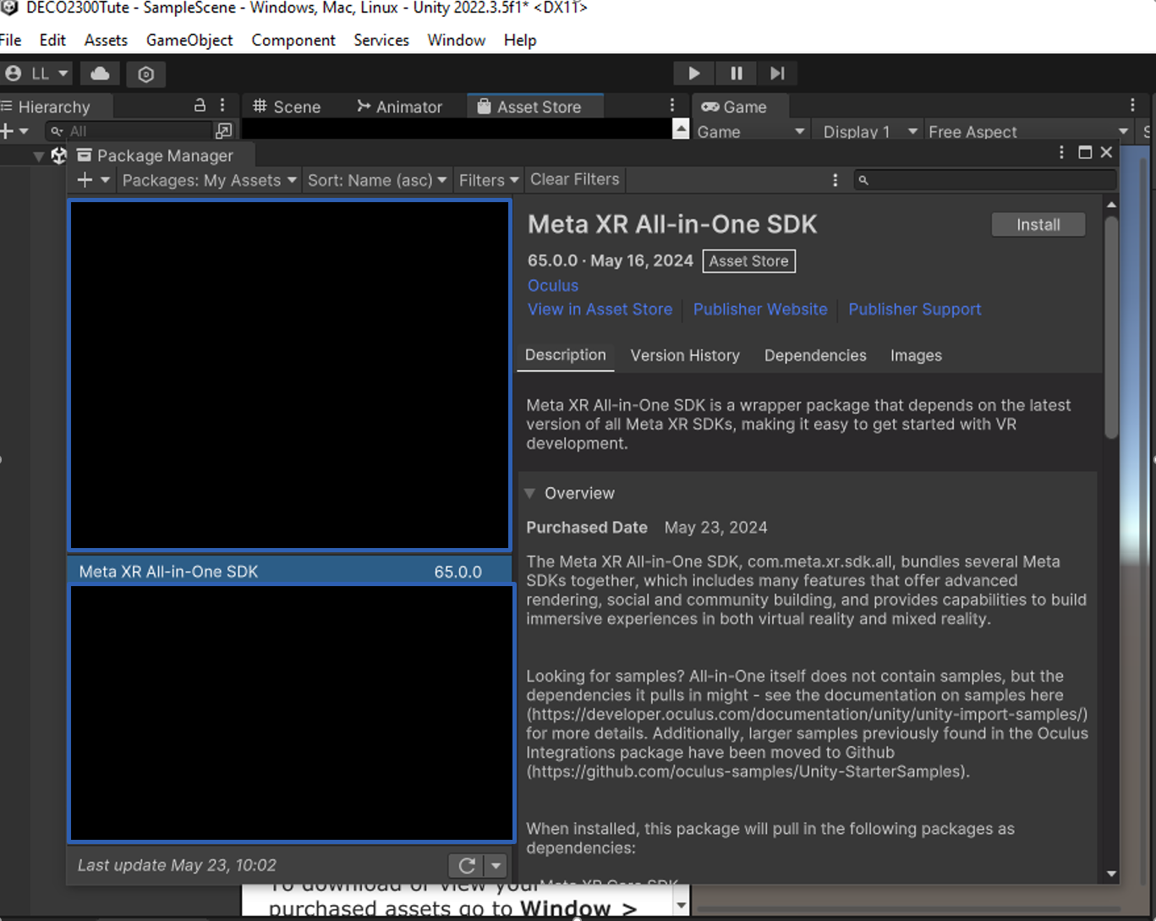
Meta XR All-in-One SDK: Install from Unity AssetStore
From Asset Store -> Search “Meta XR All-in-One SDK” -> Add to My Assets
You may also do so with the link: Meta XR All-in-One SDK | Integration | Unity Asset Store
You should then find it in Unity’s Package Manager
Click Install to import it to our project
Notes:
Place an object in scene. Explain each window. Move, scale and rotate the GameObject. Explain each of these. Create and add a script then move to the next slide.

Slide 25
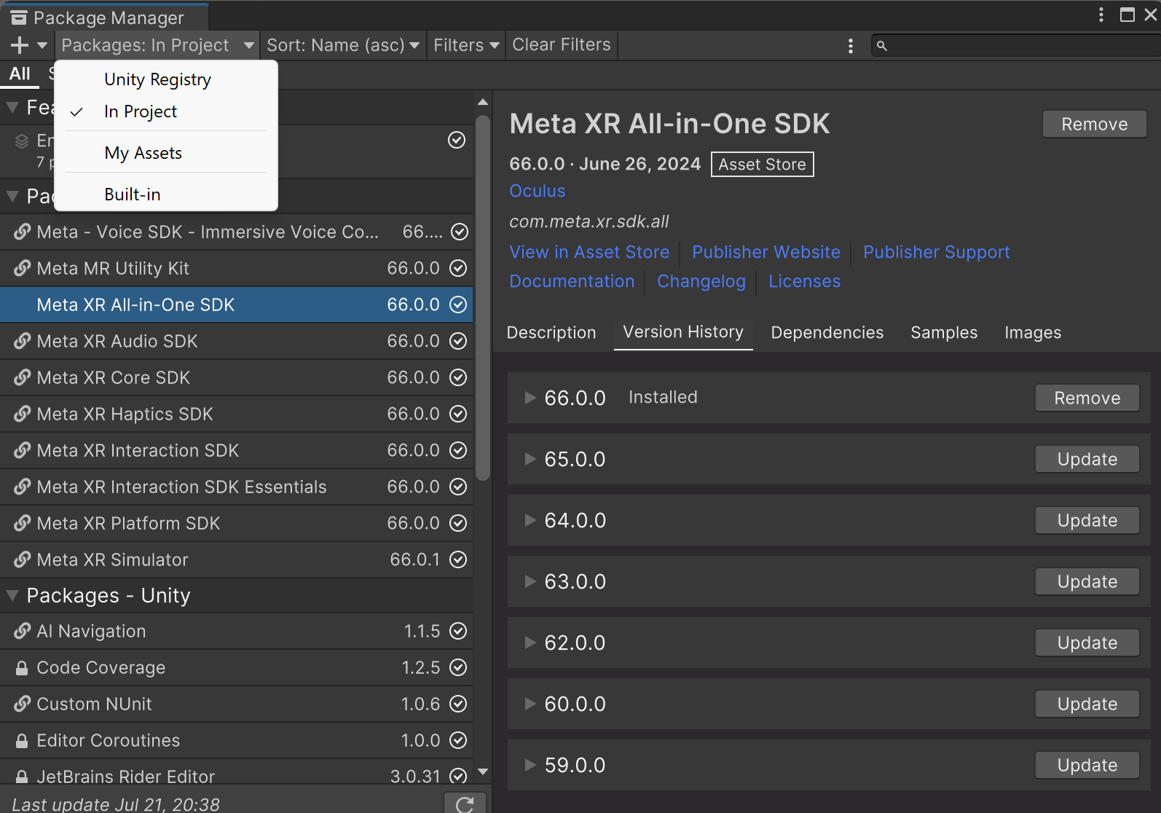
Meta XR All-in-One SDK: Downgrade to v65.0.0
1
We need to downgrade Meta SDK to v65.0 for its XR simulator to properly work on lab devices
Go to Window > Package Manager > Change the scope of Packages to “In Project” > find Meta All-in-One SDK > Click Version History > Click the Update button next to 65.0.0
2
3
Notes:
Place an object in scene. Explain each window. Move, scale and rotate the GameObject. Explain each of these. Create and add a script then move to the next slide.

Slide 26
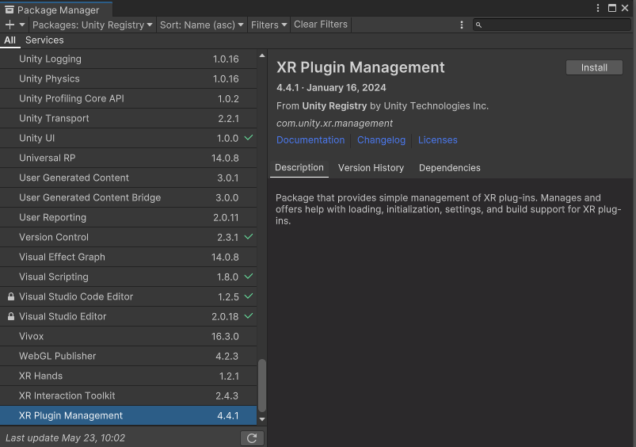
Meta XR All-in-One SDK: Install XR Plugin Management
We also need to install XR Plugin Management from Package Manager.
Window -> Package Manager -> Packages: Unity Registry -> Install XR Plugin Management
Notes:
Place an object in scene. Explain each window. Move, scale and rotate the GameObject. Explain each of these. Create and add a script then move to the next slide.

Slide 27
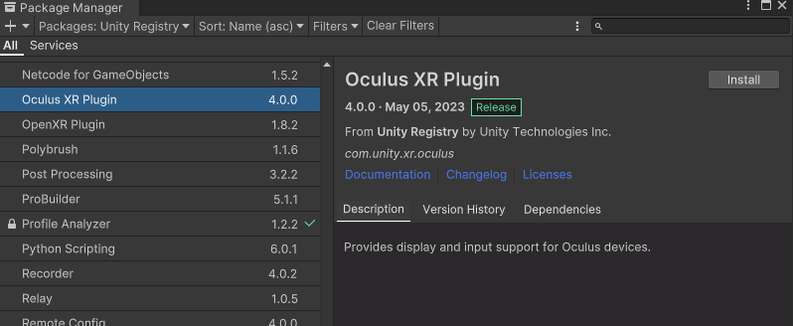
Meta XR All-in-One SDK: Install XR Plugin Management and Oculus XR Plugin
We also need to install XR Plugin Management and Oculus XR Plugin from Package Manager.
Window -> Package Manager -> Packages: Unity Registry
Notes:
Place an object in scene. Explain each window. Move, scale and rotate the GameObject. Explain each of these. Create and add a script then move to the next slide.

Slide 28
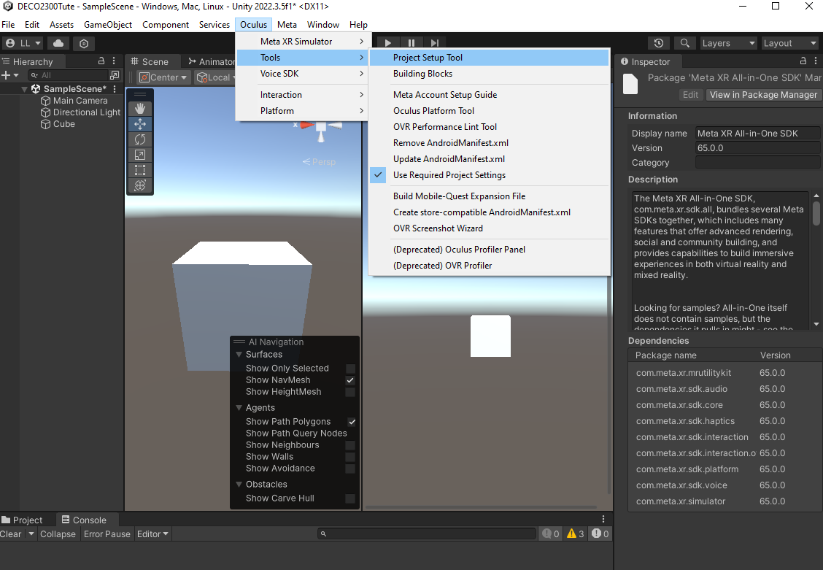
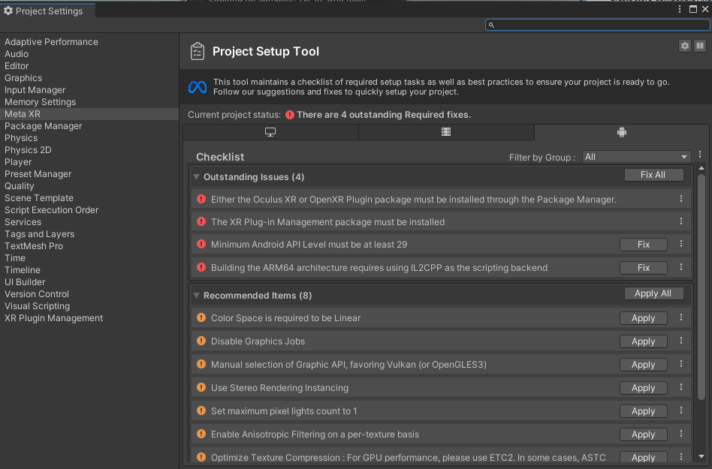
Meta XR All-in-One SDK: Set-up for XR Development
Once loaded, you will find a tab named “Oculus” on the top menu of the editor
On the menu, go to Edit > Project Settings > Meta XR, or Oculus > Tools > Project Setup Tool.
Click on the Android Icon > Click Fix All and Apply All to quickly set up your project for XR
Notes:
Place an object in scene. Explain each window. Move, scale and rotate the GameObject. Explain each of these. Create and add a script then move to the next slide.

Slide 29
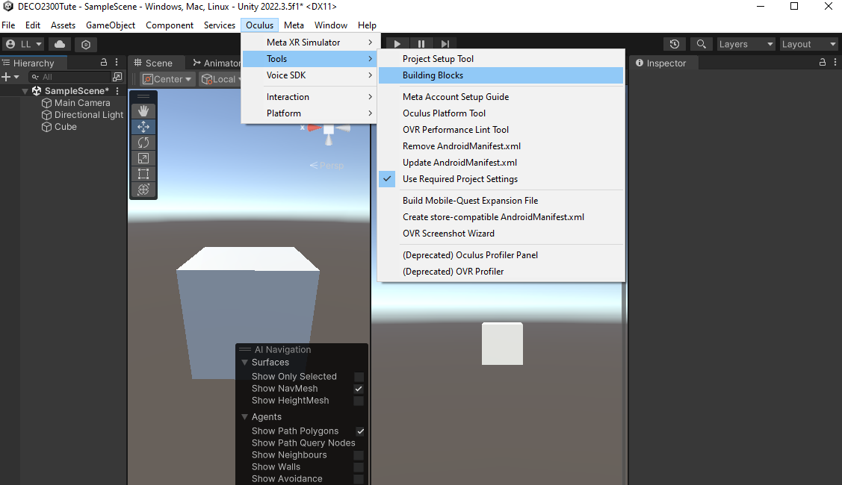
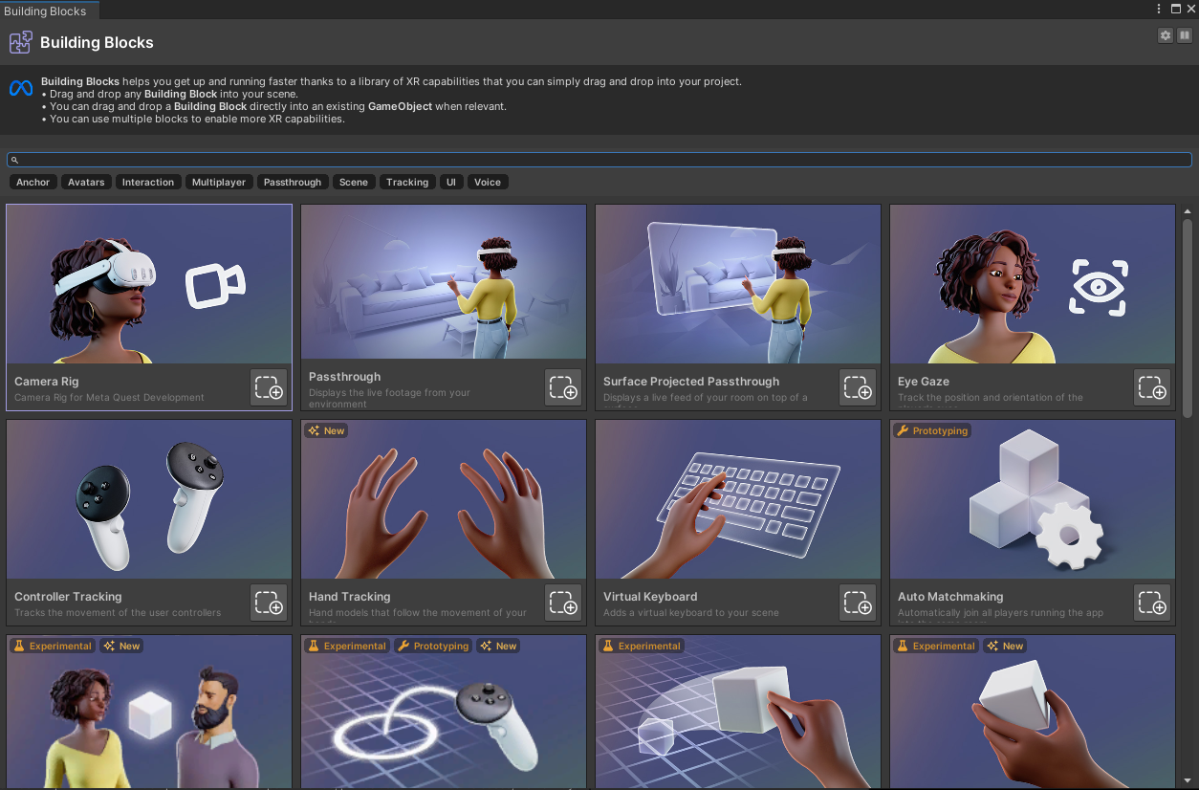
Meta XR All-in-One SDK: Introduction to Meta Building Block
Now, let’s quickly make our scene XR ready
On the Menu, go to Oculus > Tools > Building Blocks
This tool offers a set of blocks each representing an atomic feature you can add to your project by clicking on it’s install button or by dragging and dropping it onto your scene.
Notes:
Place an object in scene. Explain each window. Move, scale and rotate the GameObject. Explain each of these. Create and add a script then move to the next slide.

Slide 30
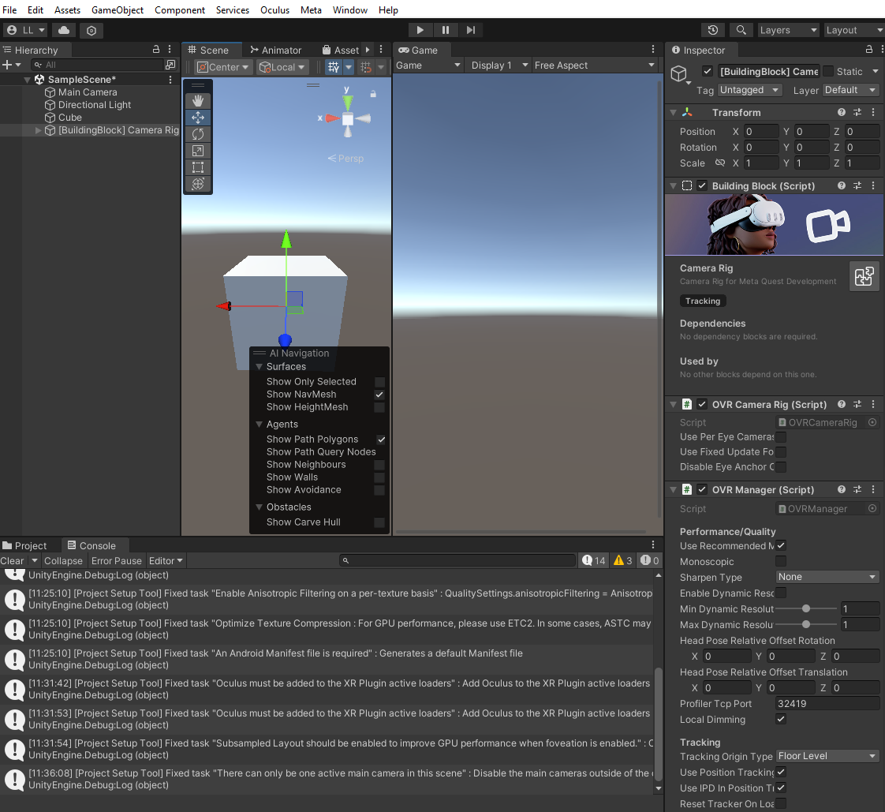
Meta XR All-in-One SDK: Meta Building Block
Let’s drag and drop Camera Rig into the Hierarchy pane
You can now delete the original Main Camera
Notes:
Place an object in scene. Explain each window. Move, scale and rotate the GameObject. Explain each of these. Create and add a script then move to the next slide.

Slide 31
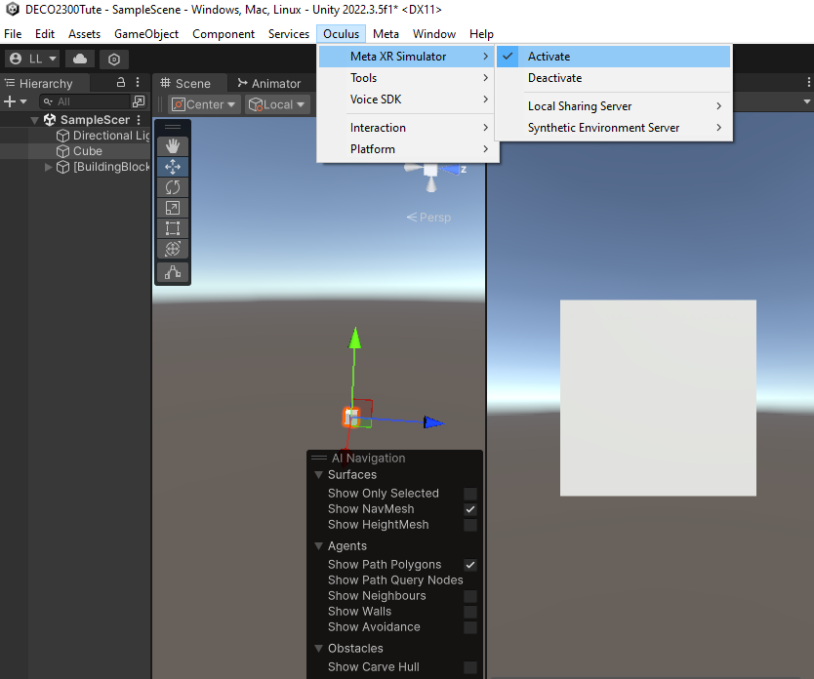
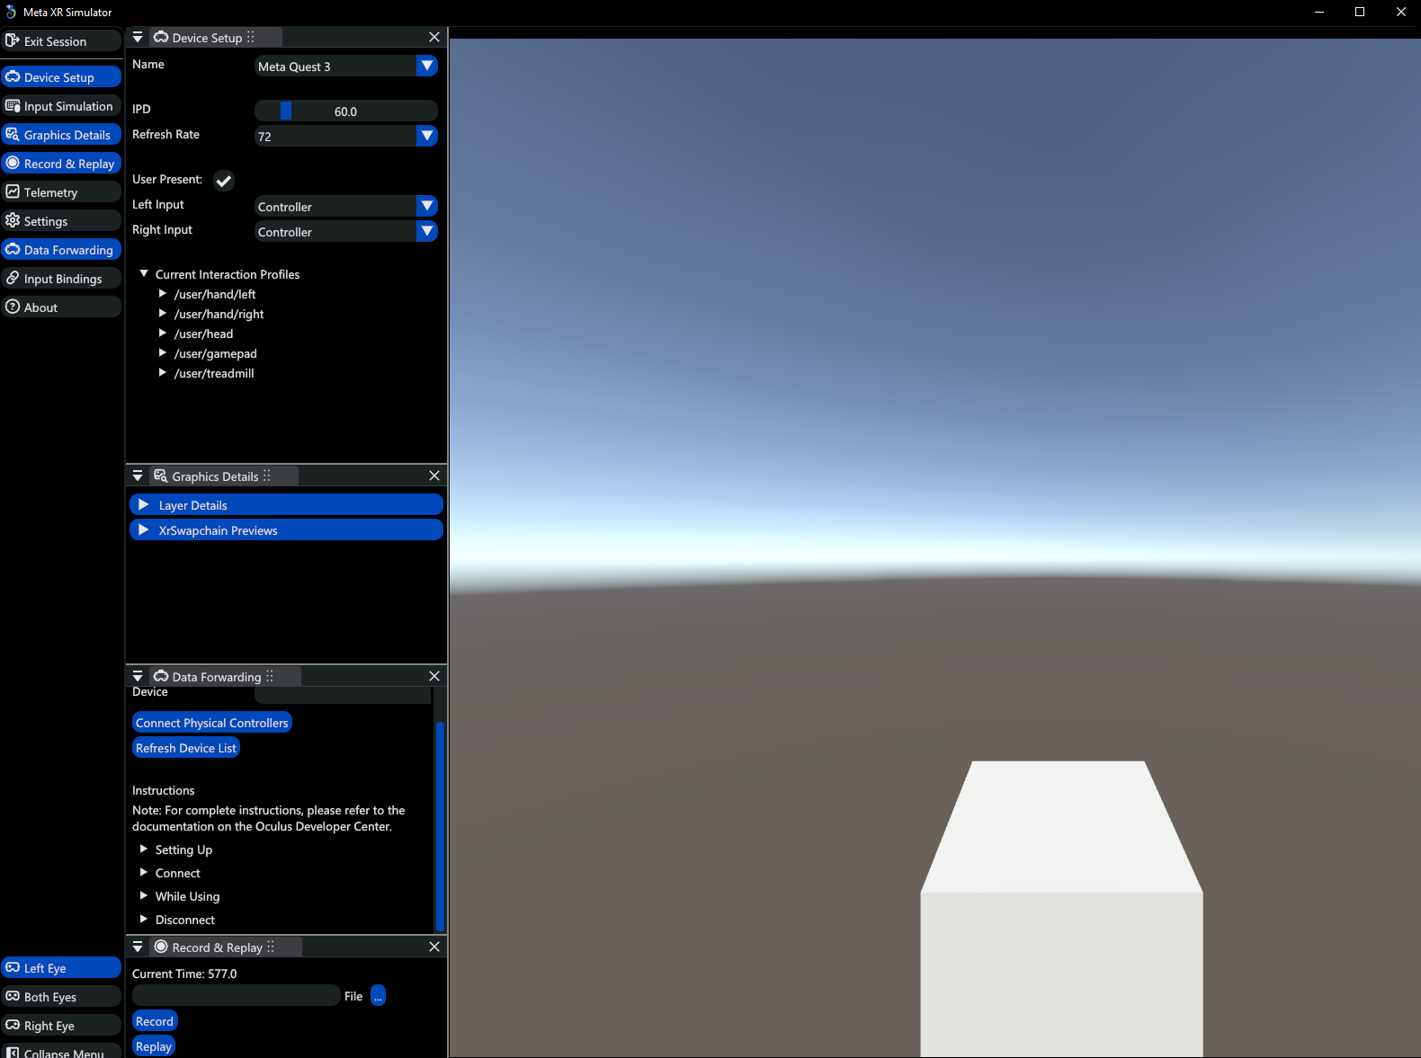
Meta XR Simulator: Test your project without a headset
On the Menu, go to Oculus > Meta XR Simulator > Activate
Hit the play button, a new window named Meta XR Simulator should pop up
You can use WASD keys to emulate movement in the scene, and right-click while moving the mouse to emulate the rotation of the head
You can check Input Simulation for the complete binding
We will introduce more about this next week
Notes:
Place an object in scene. Explain each window. Move, scale and rotate the GameObject. Explain each of these. Create and add a script then move to the next slide.

Slide 32
EXERCISE 2: More Unity Programing
Create a 3D object (e.g., a cube)
Attach a new script onto the object to change its behaviour
Write a script that will, in the Update() loop, update the transform properties:
Change the X position of the object when you press arrow keys (left/right) (use the Vector class, e.g., Vector.one)
Change the scale of the object when you press the arrow keys (up/down)
Write a script that will, in the Update() loop, update the renderer/material properties:
Change the object’s colour to RED when you press “R”
Switch materials when you press “M”
Create two materials (Right click in Projects/Assets -> Create -> Material), name them mat1 and mat2. Attach two different textures to mat1 and mat2.
Create two public variables public Material1 and public Material2. Change their Shader to Legacy Shaders -> Bump Diffuse. Download two images and attach them to the texture properties of those two materials.
Write the keyboard script logic to handle a switch case between Material1 and Material2
Transform.GetComponent<MeshRenderer>( ).material = Material;
What happens? Why?
Now drag and drop mat1 and mat2 from the editor to the Inspector
Run the code again
Write a script that will, in the Update() loop, that will apply a continuous rotation about the Y axis. You’ll need to use the Rotate() method on your transform object. You will also need a Vector3.up direction to apply the rotation and use a constant time increment to apply a smooth increment: Time.deltaTime
If you still have time, accelerate/decelerate the rotation with the +/- keys
* Note: click the game view to enable capturing the keyboard interactions. You can drag and drop that window and put it side by side with the #Scene tab.
Notes:
Walk around and help them, if they are going good then do some examples on the main screen. (For online you might want to keep them in main room and get them to send you text questions)
Some things to showcase while they are working in unity.
Creating a player that can move around (2D platformer)
Attaching objects as children (Parent the camera to the player object)
Do what your hear tells you.

Slide 33
Final Remarks

